Slide 1
Applications of TRigonometry
Year 10 Mathematics

Slide 2

Tasks
24
7
30
Essential Question
You should be ticking these off!
Complete the tasks on this side (left) of your page
Questions
Notes
Steps
Write your notes on this side (right) of your page
Your book, your responsibility!
Summary
Have YOU been doing your summaries?

Slide 3
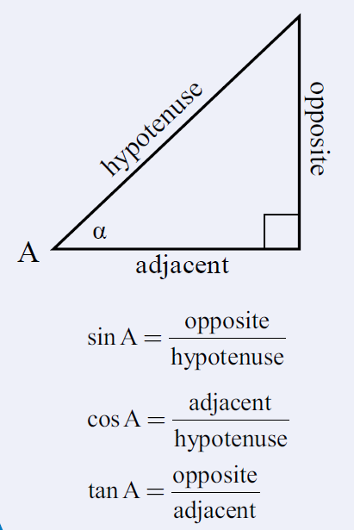

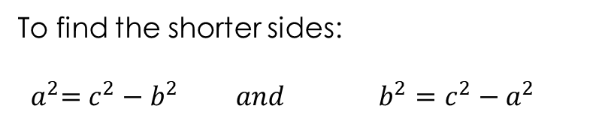
Solving Right Angle Triangle Problems
Pythagoras Theorem
Trigonometry Ratios
c
a
b
$$a^{2}+ b^{2}= c^{2}$$
To find the shorter sides:
$${ a}^{2}=c^{2}−b^{2} and b^{2}=c^{2}−a^{2}$$

Slide 4
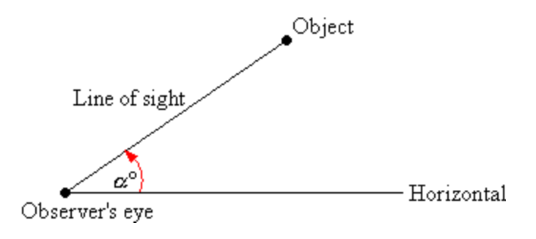
24
7
30
Date: /9/2018
Trigonometry
EQ – How do we apply trigonometry to solve right angled triangle problems?
The angle of elevation of an object as seen by an observer is the angle between the horizontal and the line from the object to the observer's eye (the line of sight).
What is an angle of elevation?

Slide 5
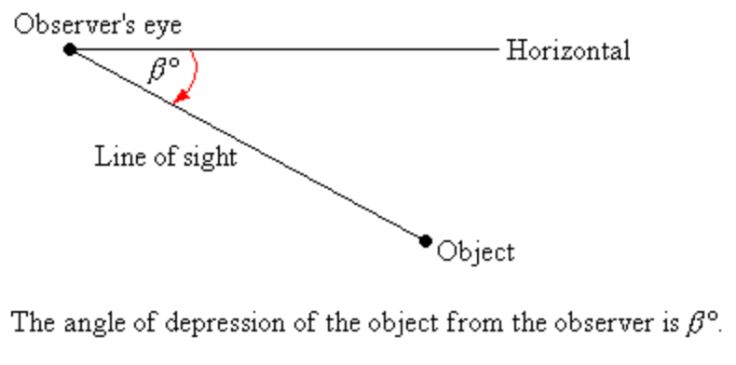
24
7
30
Date: /9/2018
Trigonometry
EQ – How do we apply trigonometry to solve right angled triangle problems?
If the object is below the level of the observer, then the angle between the horizontal and the observer's line of sight is called the angle of depression.
What is an angle of depression?

Slide 6
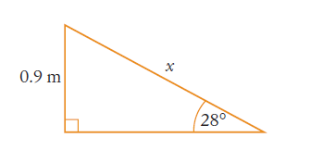




24
7
30
Date: /9/2018
Trigonometry
EQ – How do we apply trigonometry to solve right angled triangle problems?
How do I apply a trigonometry ratio?

Slide 7
24
7
30
Date: /9/2018
Trigonometry
EQ – How do we apply trigonometry to solve right angled triangle problems?
From the top of a vertical cliff, the angle of depression of a ship on the surface of the ocean level with the base of the cliff is 34º. The ship is 60m away from the cliff. How high is the cliff?
How do I apply a trigonometry ratio?

Slide 8
Task
You will be given a selection of right angle triangle related problems in an envelope.
Working with a partner:
Sort the problems into two piles according to whether you would use Pythagoras or a trigonometric ratio to answer the question.
Answer each question.

